Slide 1
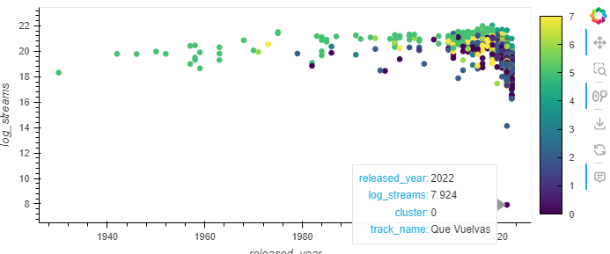
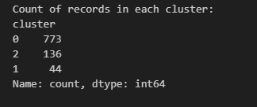
ML Clustering K-Mean
K-means is a machine learning technique that groups data points into a fixed number of clusters. It works by iteratively adjusting cluster centroids to minimize the distance between data points and centroids, revealing natural groupings within the data.
Description:
The dataset has been clustered using K-Means into three groups based on features like released year, streams, BPM, danceability, valence, and energy.
Insights:
Cluster 0: Largest cluster with 773 records.
Cluster 2: Second largest with 136 records.
Cluster 1: Smallest cluster with 44 records.

Slide 2
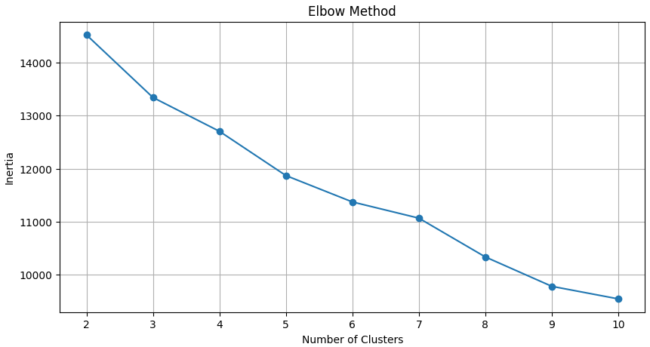
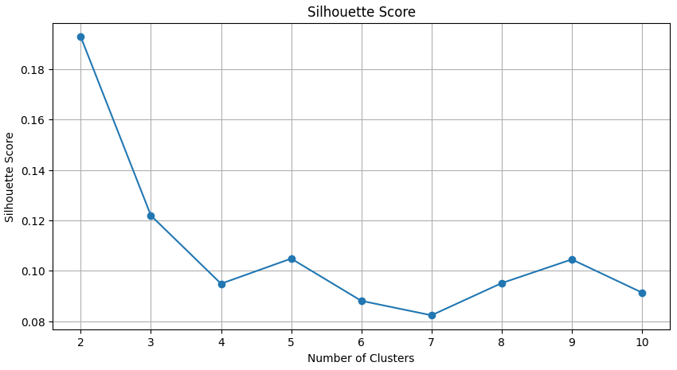
-The Elbow Method is a technique used to determine the optimal number of clusters in a dataset for KMeans clustering.
-Silhouette Method: The Silhouette Method is a measure of how similar an object is to its own cluster (cohesion) compared to other clusters (separation).

Slide 3
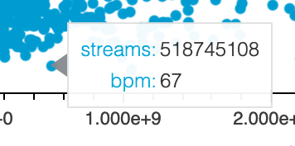
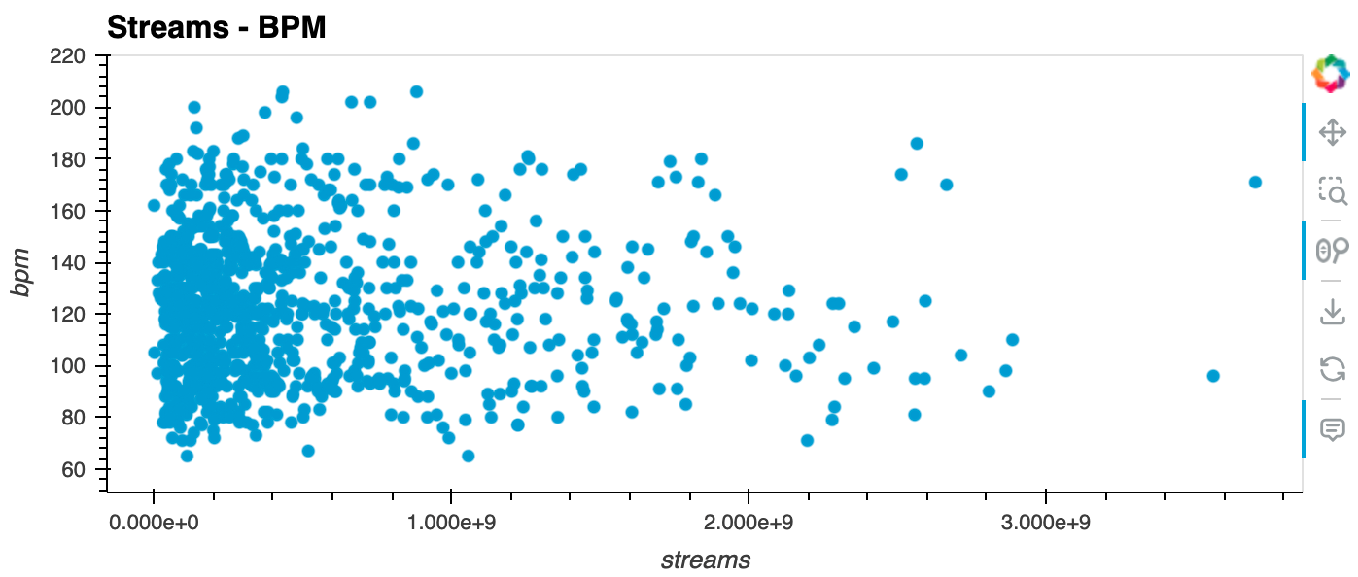
Linear Regression Model

Slide 4
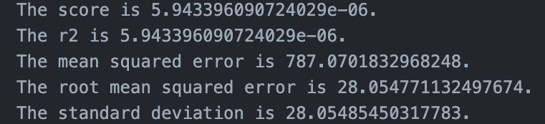
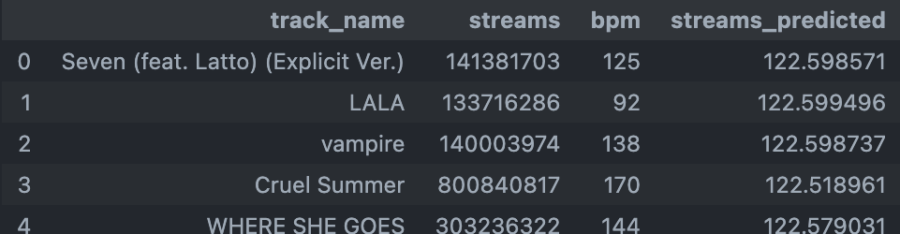
Good fit?
Based on these performance metrics, the linear regression model does not appear to be a good fit for our data.
The model is not able to capture the underlying relationships between beats per minute (bpm) and streams.

Slide 5
References:
Dataset - https://www.kaggle.com/datasets/nelgiriyewithana/top-spotify-songs-2023
Painting on cover page - https://www.fizdi.com/musical-art-17-art_1522_20733-handpainted-art-painting-24in-x-24in/

Slide 6
Questions?
Thank you!

